Slide 1
Car Accident Severity Prediction
Capstone Project

Slide 2
Business Problem and Goal
Target Audience: City Municipality of Seattle
Problem: Budget Deficiency
Major Contributor to the Deficiency: Overspending on resources deployment that cover damage control caused by car accidents.
Resources Overview: Resources comprise of staff who address human injuries such as EMT’s and staff who are dedicated to damage control caused by natural events (e.g. storms) such as firefighters.
Goal: Allocate medical and natural damage control resources more efficiently and effectively based on the predicted severity type of an accident.

Slide 3
Data Overview
Selected Y variable (target): Severity Code
Severity code is either human injury or property damage.
Selected X variables (features):
Human Behavior Factors: Driver Under the Influence, Speeding, & Pedestrian Not Granted Right of Way
Natural Events Factor: Weather Condition
Variables’ data type: Class (string), majority in binary format
Data Cleanings & Structuring
Addressed null values: default as “N” for majority of variables, one variable defaulted as “Unknown”.
Balanced Dataset: Create a separate balanced dataset where number of observations of unique severity codes are equal.

Slide 4
Machine Learning Models
Selection Reasoning: Dataset is supervised and composite of variables that hold data of the type “class” & the predicted variable is in binary format.
Models Operated: Decision Tree, Random Forest, Logistic Regression, Knn, & SVM.
Data Input: Each model was operated twice, first with the unbalanced dataset and then with the balanced dataset.

Slide 5
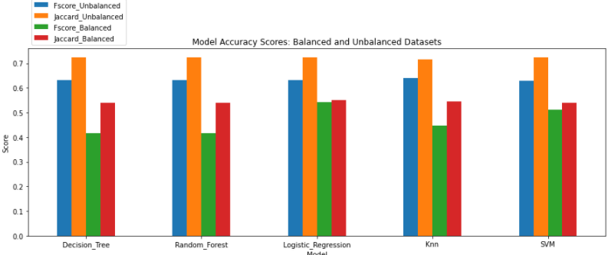
Accuracy Scores
F1-Score and Jaccard Index are constant across all models per dataset type (balanced vs unbalanced)

Slide 6
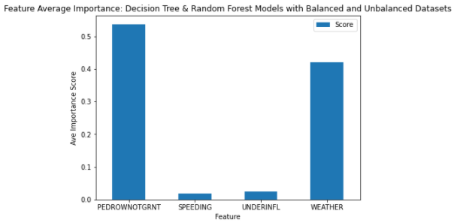
Feature Importance Scores
Pedestrian & Weather features are the major contributors to Decision Tree and Random Forest models performance

Slide 7
Conclusion
Since the accuracy scores are constant across all models per dataset type (balanced vs unbalanced), Decision Tree model with the unbalanced dataset is the most suitable algorithm to adopt due to the below main reasons:
Less time processing in comparison to other models, especially Knn and SVM.
Feature Importance Score beneficial in quickly identifying features usefulness levels (only available with Decision Tree and Random Forest models).

